Slide 1
Software Engineering
Design Patterns
CS 1530
FALL 2020
Instructor: Sohel Sarwar
University of PITTSBURGH
Lecture 10

Slide 2
DESIGN PATTERN
(Factory, Abstract Factory, & Strategy)
OVERVIEW AND EXAMPLE CODE

Slide 3
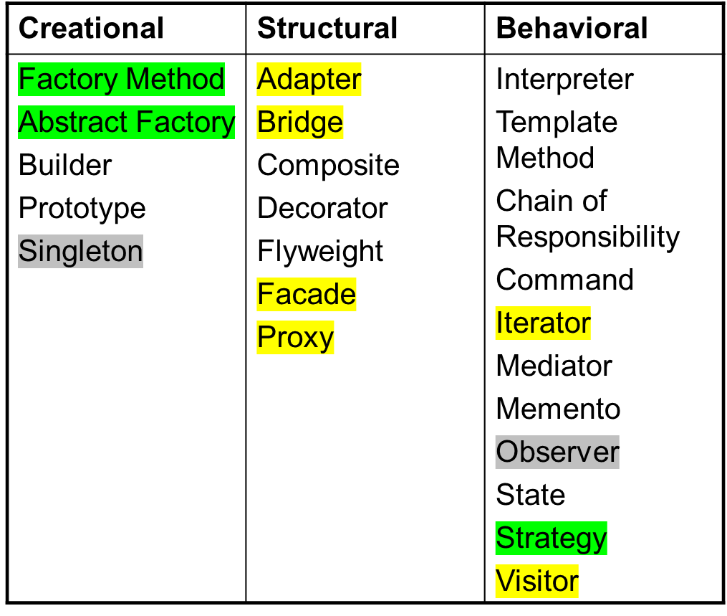
Recap
Classification of GoF Design Pattern
© E. Gamma, R. Helm, R. Johnson, J. Vlissides and Addison-Wesley

Slide 4
Factory Design Pattern (Creational)
Factory pattern is one of most used design pattern in Java. This type of design pattern comes under creational pattern as this pattern provides one of the best ways to create an object.
In Factory pattern, we create object without exposing the creation logic to the client and refer to newly created object using a common interface.
© E. Gamma, R. Helm, R. Johnson, J. Vlissides and Addison-Wesley

Slide 5
Factory Design Pattern
Intent:
  Define an interface for creating an object, but let subclasses decide which class to instantiate.
  Factory Method lets a class defer instantiation to subclasses.

Slide 6
Factory Design Pattern
Motivation:
  Framework use abstract classes to define and maintain relationships between objects
  Framework has to create objects as well - must instantiate classes but only knows about abstract classes - which it cannot instantiate
  Factory method encapsulates knowledge of which subclass to create - moves this knowledge out of the framework

Slide 7
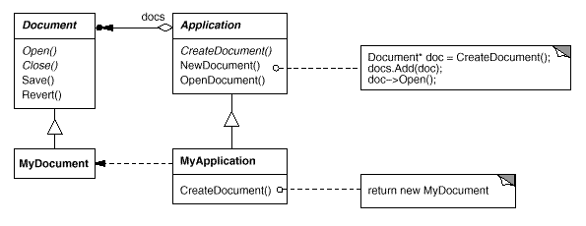
Factory Design Pattern
Structure

Slide 8
Factory Design Pattern
Applicability
Use the Factory Method pattern when
  a class can´t anticipate the class of objects it must create.
  a class wants its subclasses to specify the objects it creates.
  classes delegate responsibility to one of several helper subclasses, and you want to localize the knowledge of which helper subclass is the delegate.

Slide 9
Factory Design Pattern
Example
Example
  Car Factory produces different Car objects
  Original
    Different classes implement Car interface
    Directly instantiate car objects
    Need to modify client to change cars
  Using pattern
    Use carFactory class to produce car objects
    Can change cars by changing carFactory

Slide 10
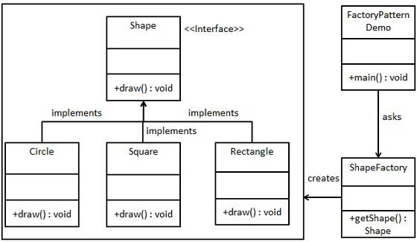
Factory Design Pattern
Class Diagram
© E. Gamma, R. Helm, R. Johnson, J. Vlissides and Addison-Wesley

Slide 11
Factory Design Pattern
Step 1
Create an interface.
Shape.java
public interface Shape {
void draw();
}

Slide 12
Factory Design Pattern
Step 2
//Create concrete classes implementing the same interface.
//Rectangle.java
public class Rectangle implements Shape {
@Override
public void draw() {
System.out.println("Inside Rectangle::draw() method.");
}
}

Slide 13
Factory Design Pattern
Step 2
//Square.java
public class Square implements Shape {
@Override
public void draw() {
System.out.println("Inside Square::draw() method.");
}
}

Slide 14
Factory Design Pattern
Step 2
//Circle.java
public class Circle implements Shape {
@Override
public void draw() {
System.out.println("Inside Circle::draw() method.");
}
}

Slide 15
Factory Design Pattern
Step 3: Create ShapeFactory.java
public class ShapeFactory {
//use getShape method to get object of type shape
public Shape getShape(String shapeType){
if(shapeType == null){
return null;
}
if(shapeType.equalsIgnoreCase("CIRCLE")){
return new Circle();
} else if(shapeType.equalsIgnoreCase("RECTANGLE")){
return new Rectangle();
} else if(shapeType.equalsIgnoreCase("SQUARE")){
return new Square();
}
return null;
}
}

Slide 16
Factory Design Pattern
Step 4: Create Demo class FactoryPatternDemo.java
public class FactoryPatternDemo {
public static void main(String[] args) {
ShapeFactory shapeFactory = new ShapeFactory();
//get an object of Circle and call its draw method.
Shape shape1 = shapeFactory.getShape("CIRCLE");
//call draw method of Circle
shape1.draw();
//get an object of Rectangle and call its draw method.
Shape shape2 = shapeFactory.getShape("RECTANGLE");
//call draw method of Rectangle
shape2.draw();
//get an object of Square and call its draw method.
Shape shape3 = shapeFactory.getShape("SQUARE");
//call draw method of circle
shape3.draw();
}
}

Slide 17
Abstract Factory Design Pattern (Creational)
Abstract Factory patterns work around a super-factory which creates other factories. This factory is also called as factory of factories. This type of design pattern comes under creational pattern as this pattern provides one of the best ways to create an object.
In Abstract Factory pattern an interface is responsible for creating a factory of related objects without explicitly specifying their classes. Each generated factory can give the objects as per the Factory pattern.
© E. Gamma, R. Helm, R. Johnson, J. Vlissides and Addison-Wesley

Slide 18
Abstract Factory Design Pattern
Intent
  Create families of related objects without specifying class names
Applicability
  When clients cannot anticipate groups of classes to instantiate
© E. Gamma, R. Helm, R. Johnson, J. Vlissides and Addison-Wesley

Slide 19
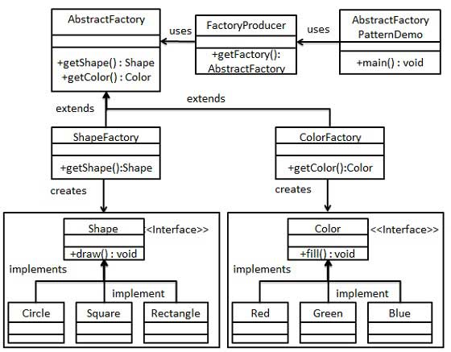
Abstract Factory Design Pattern
© E. Gamma, R. Helm, R. Johnson, J. Vlissides and Addison-Wesley

Slide 20
Abstract Factory Java Example
//Step 1
//Create an interface for Shapes.
Shape.java
public interface Shape {
void draw();
}

Slide 21
Abstract Factory Java Example
//Step 2
//Create concrete classes implementing the same interface.
//Rectangle.java
public class Rectangle implements Shape {
@Override
public void draw() {
System.out.println("Inside Rectangle::draw() method.");
}
}

Slide 22
Abstract Factory Java Example
//Step 2 Square.java & Circle.java Continued…
public class Square implements Shape {
@Override
public void draw() {
System.out.println("Inside Square::draw() method.");
}
}
public class Circle implements Shape {
@Override
public void draw() {
System.out.println("Inside Circle::draw() method.");
}
}

Slide 23
Abstract Factory Java Example
//Step 3
//Create an interface for Colors.
//Color.java
public interface Color {
void fill();
}

Slide 24
Abstract Factory Java Example
//Step4
//Create concrete classes implementing the same interface.
//Red.java
public class Red implements Color {
@Override
public void fill() {
System.out.println("Inside Red::fill() method.");
}
}

Slide 25
Abstract Factory Java Example
//Step4 Green.java & Blue.java Continued
public class Green implements Color {
@Override
public void fill() {
System.out.println("Inside Green::fill() method.");
}
}
public class Blue implements Color {
@Override
public void fill() {
System.out.println("Inside Blue::fill() method.");
}
}

Slide 26
Abstract Factory Java Example
Step 5
Create an Abstract class to get factories for Color and Shape Objects.
AbstractFactory.java
public abstract class AbstractFactory {
abstract Color getColor(String color);
abstract Shape getShape(String shape) ;
}

Slide 27
Abstract Factory Java Example
// Step 6: ShapeFactory.java
//Create Factory classes extending AbstractFactory to generate object //of concrete class based on given information.
public class ShapeFactory extends AbstractFactory {
@Override
public Shape getShape(String shapeType){
if(shapeType == null){
return null;
}
if(shapeType.equalsIgnoreCase("CIRCLE")){
return new Circle();
}else if(shapeType.equalsIgnoreCase("RECTANGLE")){
return new Rectangle();

Slide 28
Abstract Factory Java Example
// Step 6: ShapeFactory.java Continued…
}else if(shapeType.equalsIgnoreCase("SQUARE")){
return new Square();
}
return null;
}
@Override
Color getColor(String color) {
return null;
}
}

Slide 29
Abstract Factory Java Example
// Step 6: ColorFactory.java Continued…
public class ColorFactory extends AbstractFactory {
@Override
public Shape getShape(String shapeType){
return null;
}
@Override
Color getColor(String color) {
if(color == null){
return null;
}
if(color.equalsIgnoreCase("RED")){
return new Red();

Slide 30
Abstract Factory Java Example
// Step 6: ColorFactory.java Continued…
}else if(color.equalsIgnoreCase("GREEN")){
return new Green();
}else if(color.equalsIgnoreCase("BLUE")){
return new Blue();
}
return null;
}
}

Slide 31
Abstract Factory Java Example
//Step 7: FactoryProducer.java
//Create a Factory generator/producer class to get factories by //passing an information such as Shape or Color:
public class FactoryProducer {
public static AbstractFactory getFactory(String choice){
if(choice.equalsIgnoreCase("SHAPE")){
return new ShapeFactory();
}else if(choice.equalsIgnoreCase("COLOR")){
return new ColorFactory();
}
return null;
}
}

Slide 32
Abstract Factory Java Example
//Step 8: AbstractFactoryPatternDemo.java
//Use the FactoryProducer to get AbstractFactory in order to get //factories of concrete classes by passing an information such as //type.
public class AbstractFactoryPatternDemo {
public static void main(String[] args) {
//get shape factory
AbstractFactory shapeFactory = FactoryProducer.getFactory("SHAPE");
//get an object of Shape Circle
Shape shape1 = shapeFactory.getShape("CIRCLE");

Slide 33
Abstract Factory Java Example
//Step 8 Continued
//call draw method of Shape Circle
shape1.draw();
//get an object of Shape Rectangle
Shape shape2 = shapeFactory.getShape("RECTANGLE");
//call draw method of Shape Rectangle
shape2.draw();
//get an object of Shape Square
Shape shape3 = shapeFactory.getShape("SQUARE");
//call draw method of Shape Square
shape3.draw();

Slide 34
Abstract Factory Java Example
//Step 8 Continued: get color factory
AbstractFactory colorFactory = FactoryProducer.getFactory("COLOR");
//get an object of Color Red
Color color1 = colorFactory.getColor("RED");
color1.fill(); // call fill method of Red
//get an object of Color Green
Color color2 = colorFactory.getColor("Green");
color2.fill(); //call fill method of Green
//get an object of Color Blue
Color color3 = colorFactory.getColor("BLUE");
color3.fill(); //call fill method of Color Blue
}
}

Slide 35
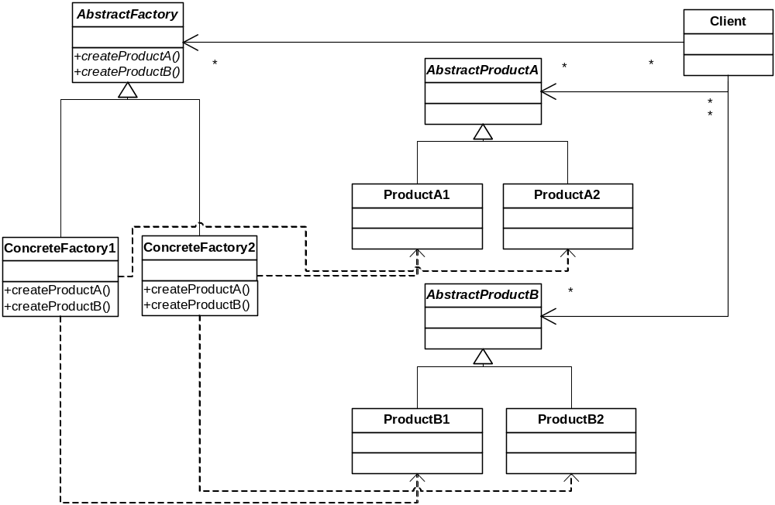
Abstract Factory (Cont'd)
Structure
«instantiate»
© E. Gamma, R. Helm, R. Johnson, J. Vlissides and Addison-Wesley
«instantiate»
«instantiate»
«instantiate»

Slide 36
Abstract Factory (Cont'd)
Consequences
  Flexibility: removes type dependencies from clients
  Abstraction: hides product's composition
  Hard to extend factory interface to create new products
Implementation
  Parameterization as a way of controlling interface size
  Configuration with Prototypes
Known Uses
  InterViews Kits
  ET++ WindowSystem
© E. Gamma, R. Helm, R. Johnson, J. Vlissides and Addison-Wesley

Slide 37
Strategy
In Strategy pattern, a class behavior or its algorithm can be changed at run time. This type of design pattern comes under behavior pattern.

Slide 38
Strategy
In Strategy pattern, we create objects which represent various strategies and a context object whose behavior varies as per its strategy object. The strategy object changes the executing algorithm of the context object.

Slide 39
Strategy
You want to
  use different algorithms depending upon the context
  avoid having to change the context or client
Strategy
  decouples interface from implementation
  shields client from implementations
  Context is not aware which strategy is being used; Client configures the Context
  strategies can be substituted at runtime
  example: interface to wired and wireless networks

Slide 40
Strategy (cont.)
Client
Policy
Context
Strategy
Concrete
StrategyA
Concrete
StrategyB

Slide 41
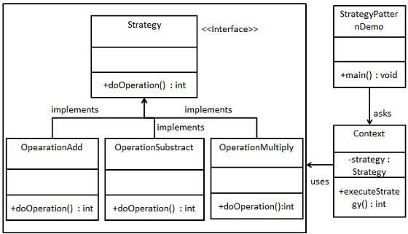
Strategy (cont.)

Slide 42
Strategy
We are going to create a Strategy interface defining an action and concrete strategy classes implementing the Strategy interface. Context is a class which uses a Strategy.
StrategyPatternDemo, our demo class, will use Context and strategy objects to demonstrate change in Context behaviour based on strategy it deploys or uses.

Slide 43
Strategy
Step 1
//Create an interface: Strategy.java
public interface Strategy {
public int doOperation(int num1, int num2);
}

Slide 44
Strategy
Step 2
//Create concrete classes implementing the same //interface: OperationAdd.java
public class OperationAdd implements Strategy{
@Override
public int doOperation(int num1, int num2) {
return num1 + num2;
}
}

Slide 45
Strategy
Step 2
//OperationSubstract.java
public class OperationSubstract implements Strategy{
@Override
public int doOperation(int num1, int num2) {
return num1 - num2;
}
}

Slide 46
Strategy
Step 2
//OperationMultiply.java
public class OperationMultiply implements Strategy{
@Override
public int doOperation(int num1, int num2) {
return num1 * num2;
}
}

Slide 47
Strategy
Step 3
// Create Context Class: Context.java
public class Context {
private Strategy strategy;
public Context(Strategy strategy){
this.strategy = strategy;
}
public int executeStrategy(int num1, int num2){
return strategy.doOperation(num1, num2);
}
}

Slide 48
Strategy
Step 4
// Use the Context to see change in behaviour when it changes its //Strategy: StrategyPatternDemo.java
public class StrategyPatternDemo {
public static void main(String[] args) {
Context context = new Context(new OperationAdd());
System.out.println("10 + 5 = " + context.executeStrategy(10, 5));
context = new Context(new OperationSubstract());
System.out.println("10 - 5 = " + context.executeStrategy(10, 5));
context = new Context(new OperationMultiply());
System.out.println("10 * 5 = " + context.executeStrategy(10, 5));
}
}

Slide 49
(Design) Pattern References
The Timeless Way of Building, Alexander; Oxford, 1979; ISBN 0-19-502402-8
A Pattern Language, Alexander; Oxford, 1977; ISBN 0-19-501-919-9
Design Patterns, Gamma, et al.; Addison-Wesley, 1995; ISBN 0-201-63361-2; CD version ISBN 0-201-63498-8
Pattern-Oriented Software Architecture, Buschmann, et al.; Wiley, 1996; ISBN 0-471-95869-7
Analysis Patterns, Fowler; Addison-Wesley, 1996; ISBN 0-201-89542-0
Smalltalk Best Practice Patterns, Beck; Prentice Hall, 1997; ISBN 0-13-476904-X
The Design Patterns Smalltalk Companion, Alpert, et al.; Addison-Wesley, 1998; ISBN 0-201-18462-1
AntiPatterns, Brown, et al.; Wiley, 1998; ISBN 0-471-19713-0

